Slide 1
Wireless Communications
Principles and Practice
2nd Edition
Prentice-Hall
Chapter 1: Introduction to Wireless Communication Systems
Prof. Theodore S. Rappaport
University of Texas at Austin
www.wncg.org

Slide 2
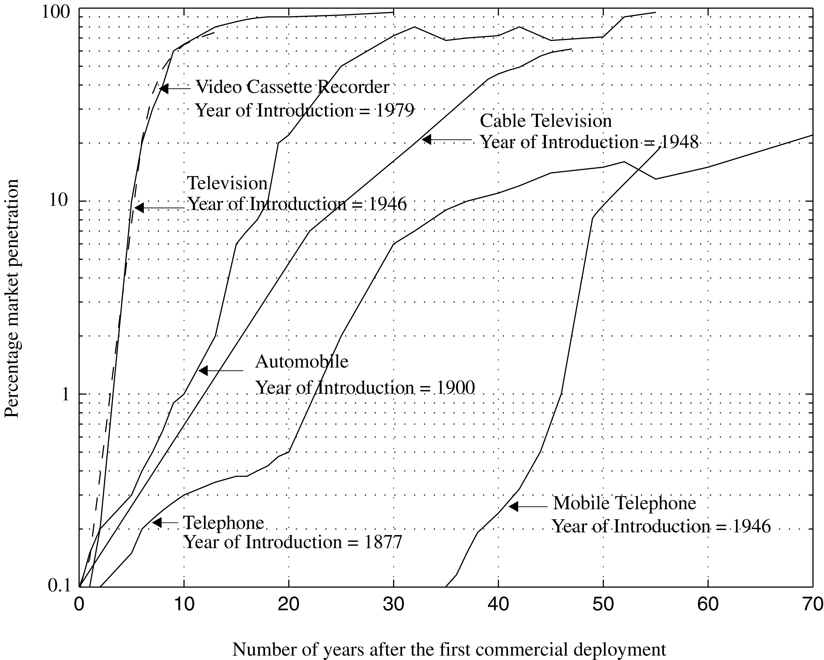
The electronics boom
Figure 1.1 The growth of mobile telephony as compared with other popular inventions of the 20th century.
Notes:
Fig. 1.1

Slide 3
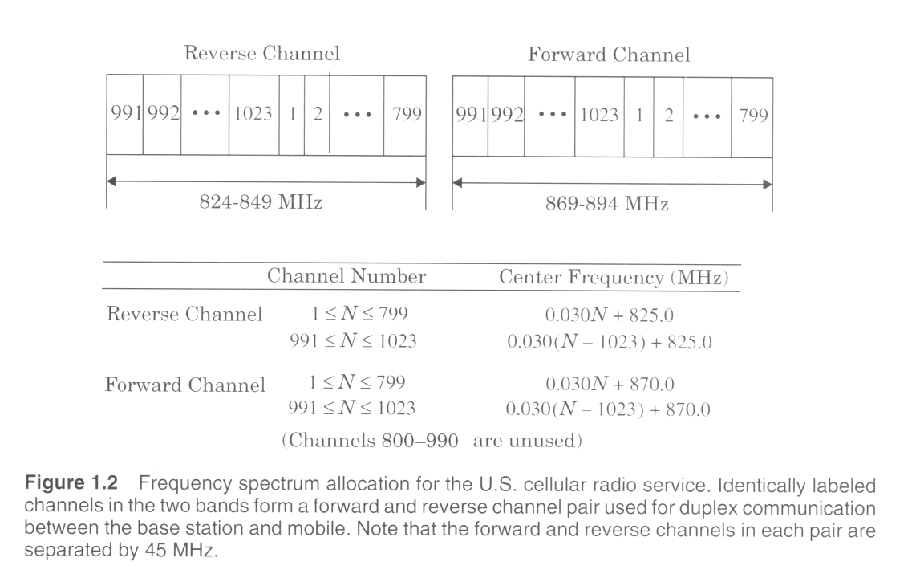

Slide 4
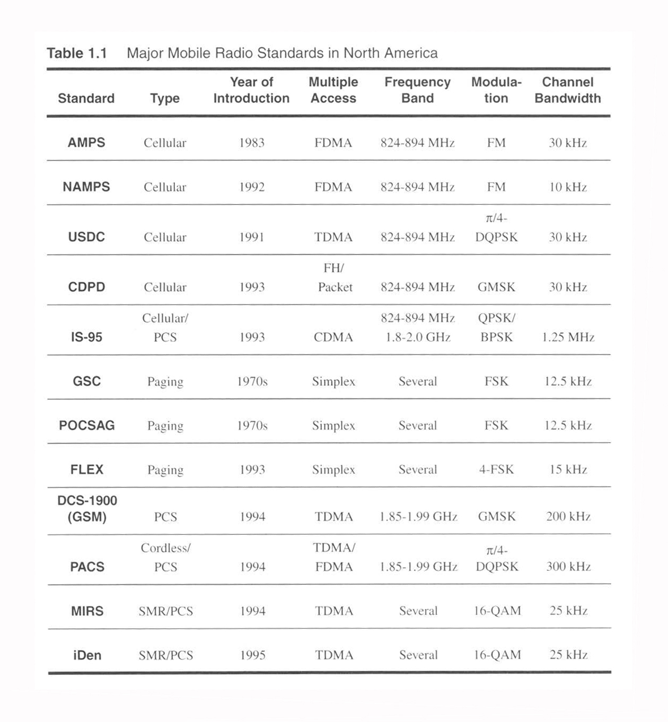

Slide 5
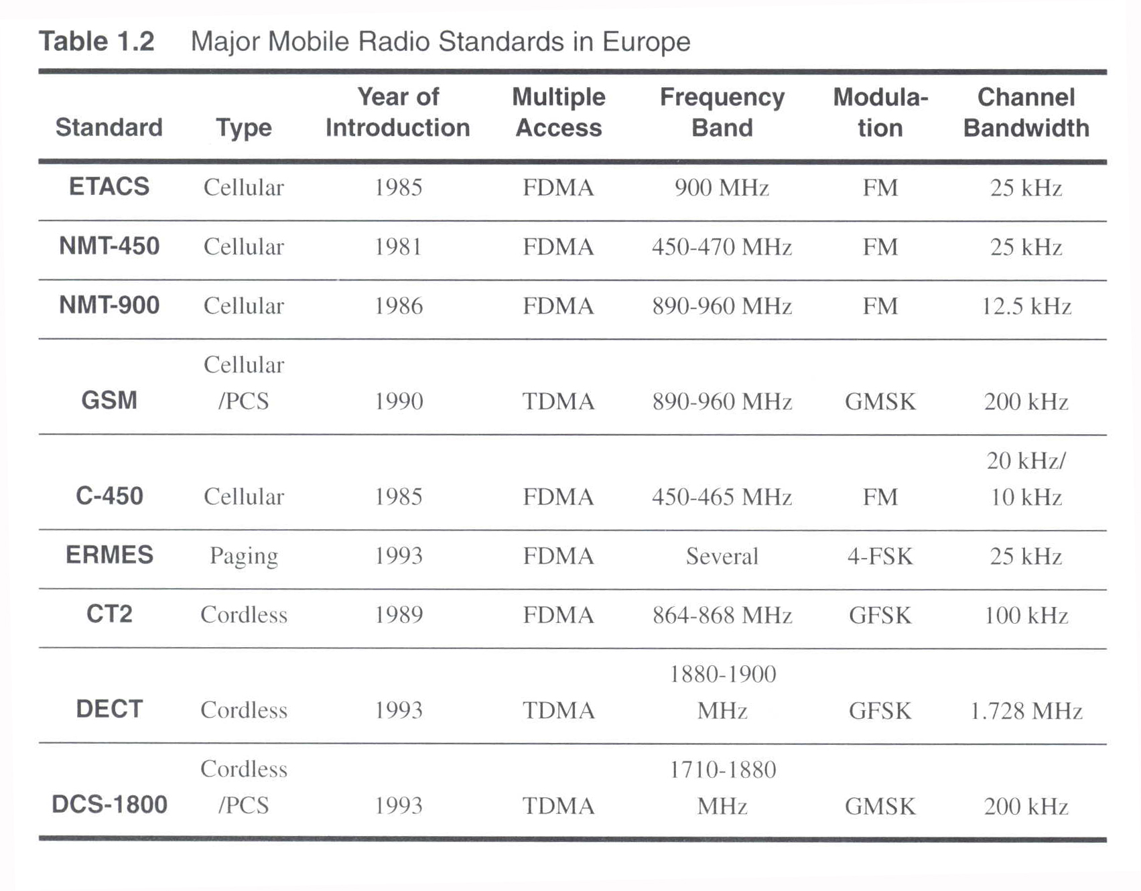

Slide 6
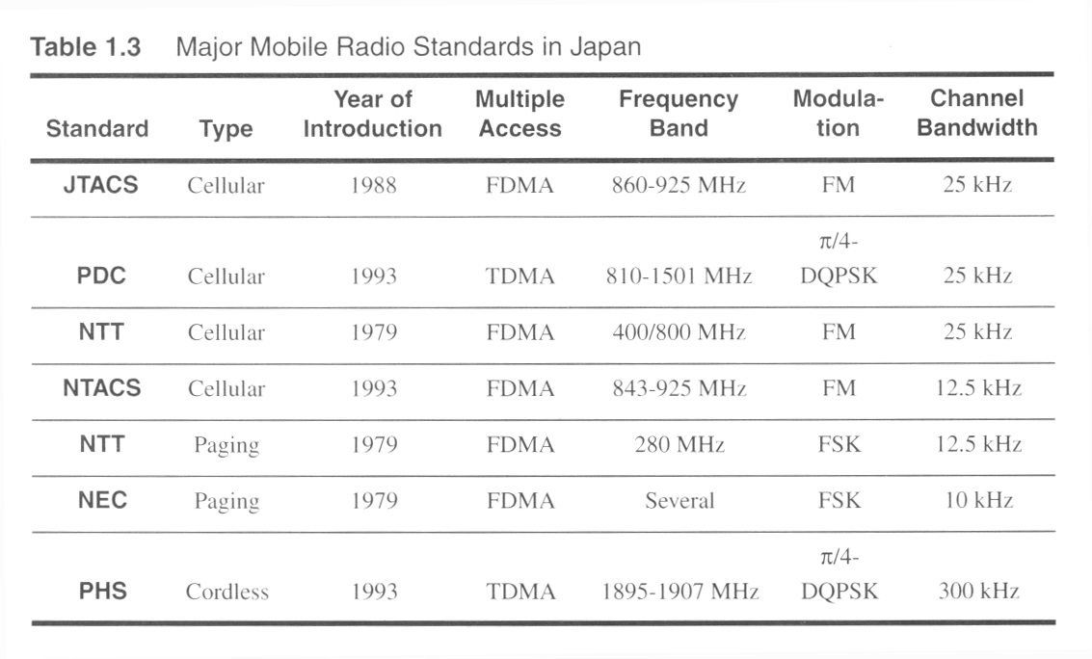

Slide 7
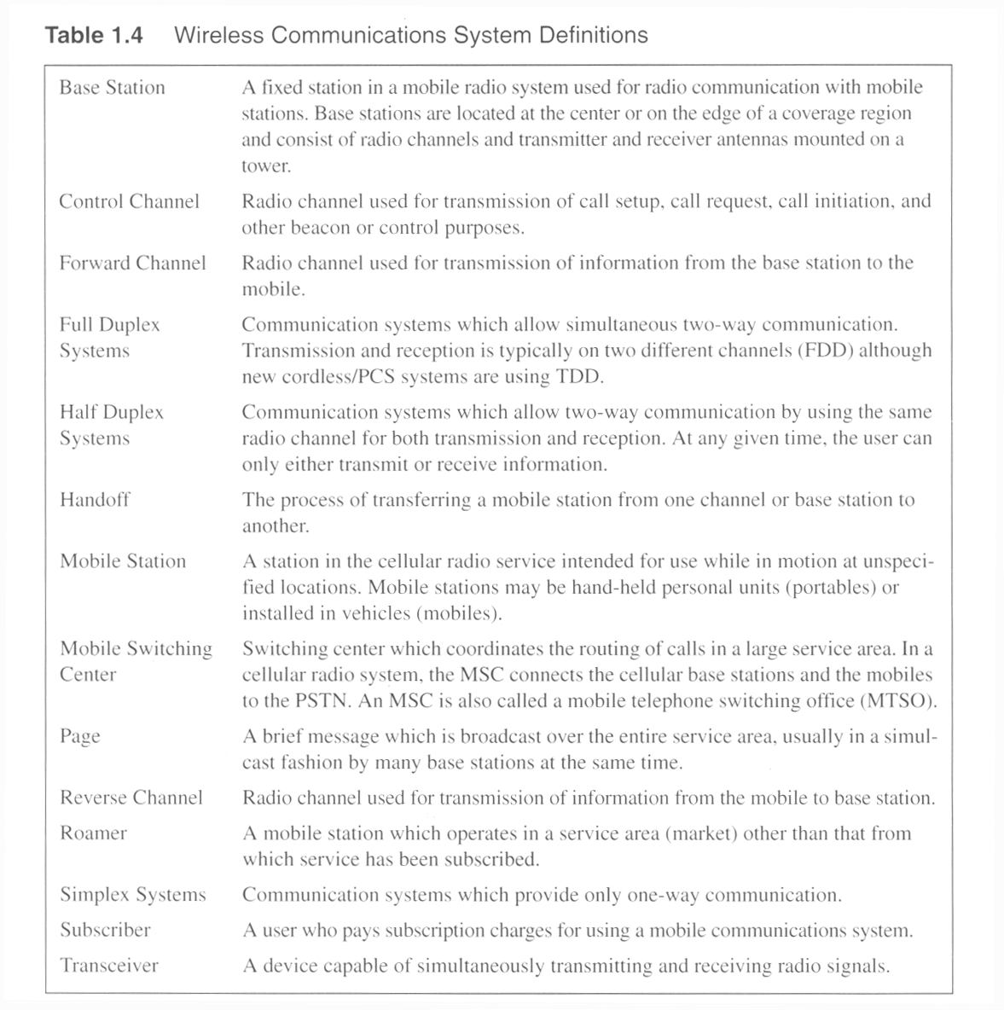

Slide 8
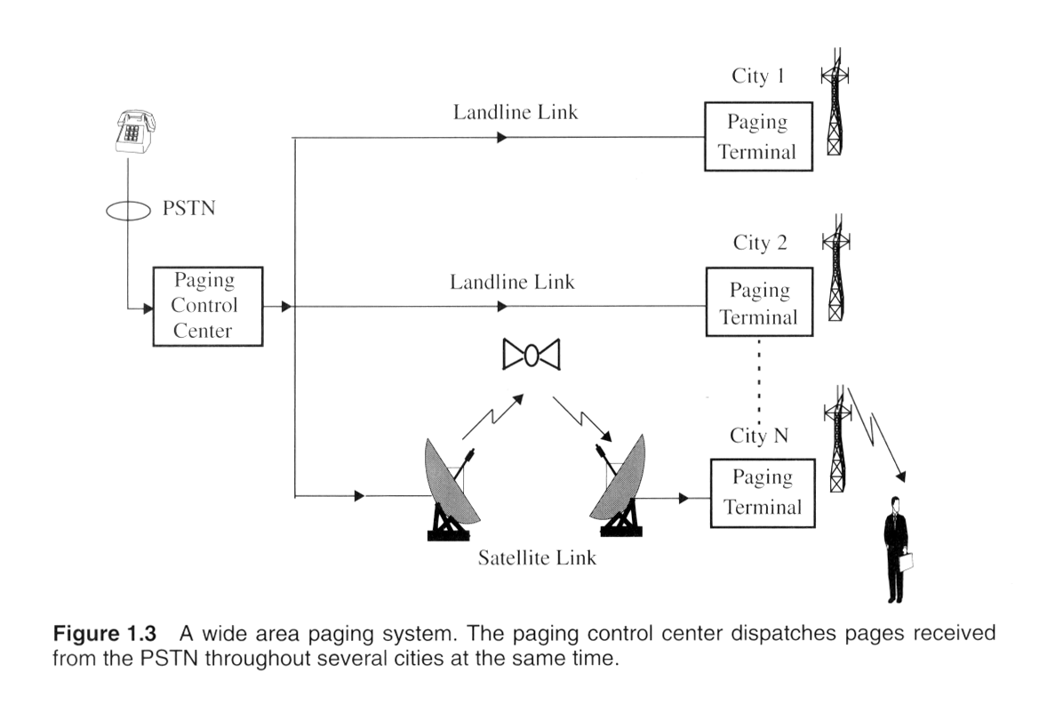

Slide 9
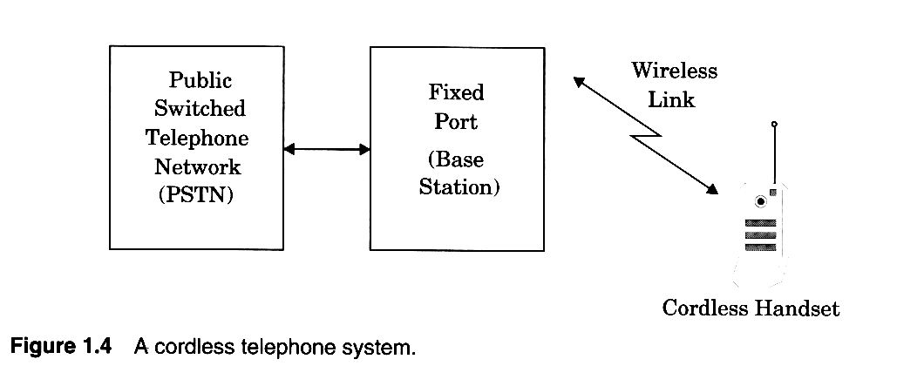


Slide 10
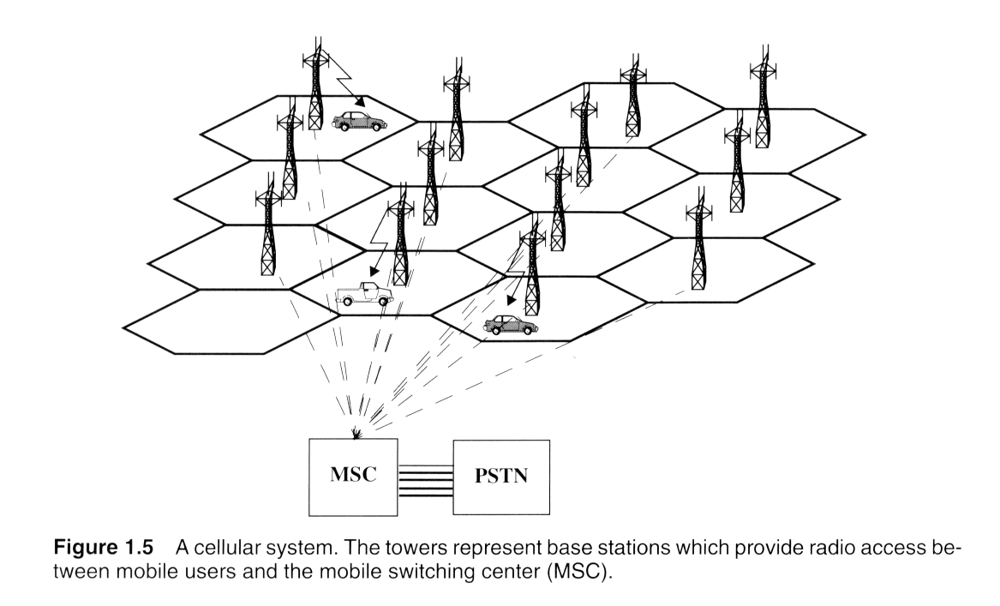

Slide 11
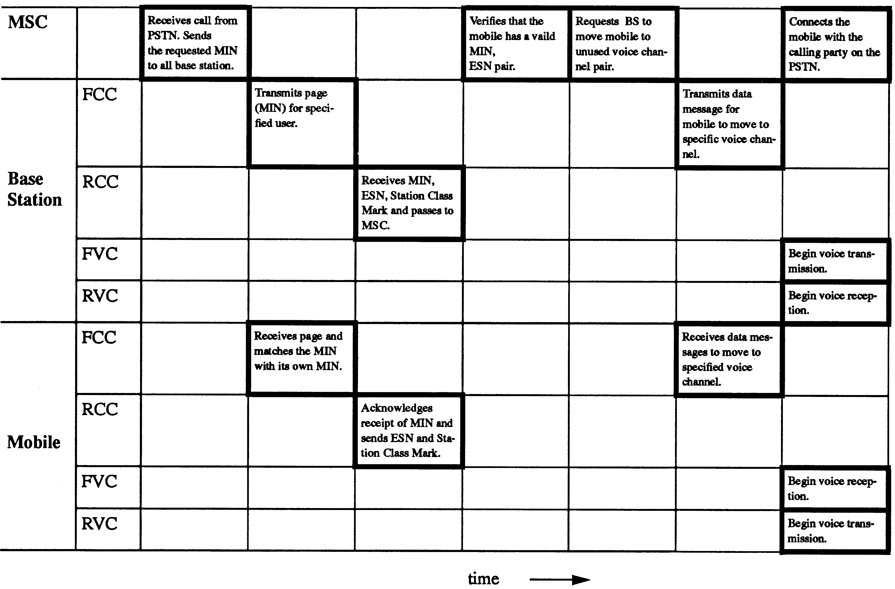
Figure 1.6 Timing diagram illustrating how a call to a mobile user initiated by a landline subscriber is established.
Notes:
Fig. 1.6

Slide 12
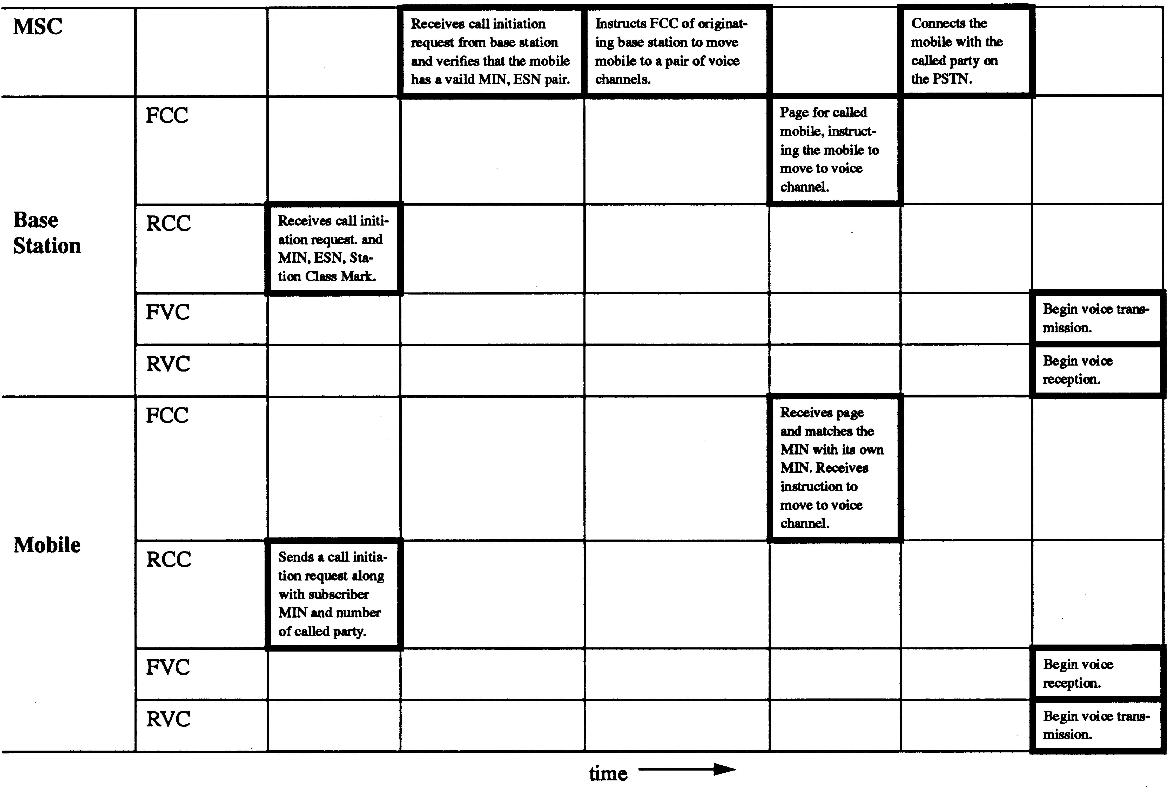
Figure 1.7 Timing diagram illustrating how a call initiated by a mobile is established.
Notes:
Fig. 1.7

Slide 13
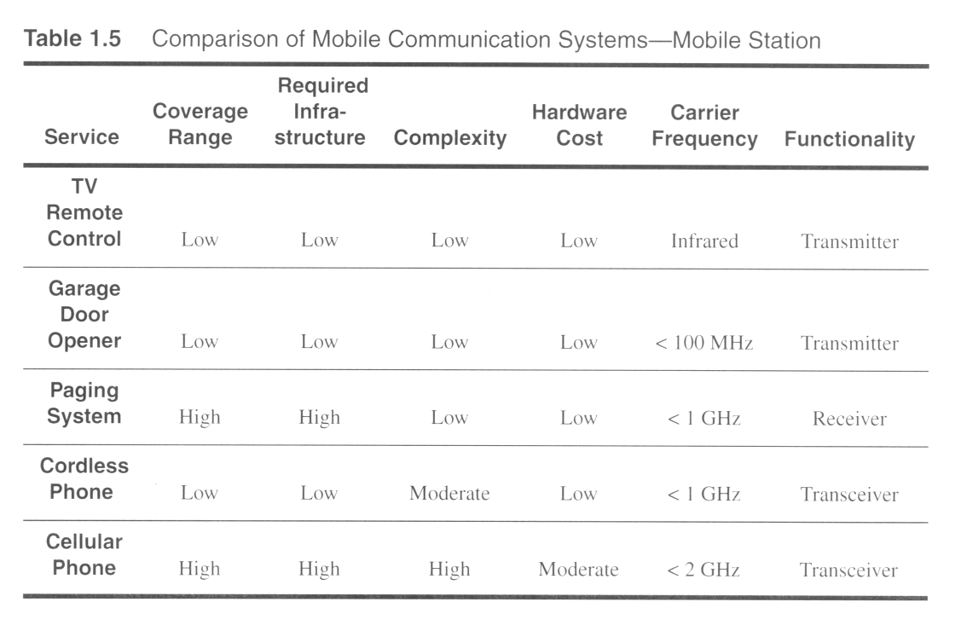

Slide 14
